Slide 1
KeyLogger and The Security Concerns With KeyLogger In
CyberSecurity
Presented by: Silky Jain(January Batch)

Slide 2
Introduction
Cybercriminals have devised many methods to obtain sensitive information from your endpoint devices. However, few of them are as effective as keystroke logging. Using this approach, an attacker can obtain valuable data without cracking into a hardened database or file server.
Keylogging presents a special challenge to security managers. Unlike traditional worms and viruses, certain types of keyloggers are all but impossible to detect.
In this presentation, I examine how keyloggers work. I look at the various types of keyloggers and how they differ. Finally, I explore ways to prevent keylogging and how to respond if a keylogger is discovered.

Slide 3
What is Keylogger
Keyloggers are hardware or software tools that capture characters sent from the keyboard to an attached computer, to gain fraudulent access to passwords and other confidential information. They have both lawful/ethical and unlawful/unethical applications. Keylogging is also known as Keystroke logging.
There are following purpose to use Keyloggers.
To monitor employee performance
To access confidential information
Law enforcement or private investigators looking for evidence of an ongoing crime or inappropriate behavior etc.

Slide 4
Types of Keyloggers
There are different types of Keyloggers.
Hardware Keyloggers
Keyboard Overlays
Wireless Intercept
Acoustic
Software Keyloggers

Slide 5
Hardware Keyloggers
Hardware Keyloggers are small electronic devices used for capturing the data in between a keyboard device and I/O port.
Usually these devices have built in memory where they store the keystrokes so this means they must be retrieved by the person who installed it in order to obtain the information.
Hardware Keyloggers are undetectable by anti-viral software or scanners since it works on the hardware platform.

Slide 6
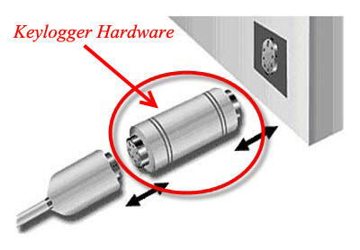
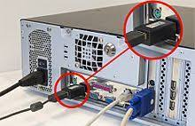
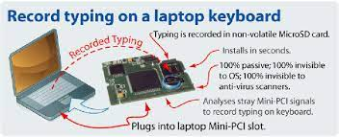

Slide 7
Another method is to install a keylogger circuit into a standard keyboard. This has no physical evidence of user monitoring.
Laptops present a special challenge. External keyloggers are not an option unless the portable computer never leaves its docking station, and an external keyboard is used. So devices must be installed in the laptop. Figure below is an example of a mini-PCI hardware keylogger.

Slide 8
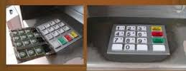
Keyboard Overlays
Overlays are popular in ATM theft cases where thieves capture a user's PIN number. This device is designed to blend in with the machine so that people are unaware of its presence.

Slide 9
Wireless Intercept
It is possible for the signals sent from a wireless keyboard to its receiver to be intercepted by a wireless sniffer.
The good news is that transmission range is limited to six feet. The bad news is that there is an RF transmission radius of six feet. And although wireless keyboard manufacturers encrypt RF transported keystroke characters, the encryption is very weak.
The one big disadvantage of using wireless intercept keyloggers is the need for a receiver/antenna relatively close to the target system. However, it’s easy to hide small antennas in most office environments.

Slide 10
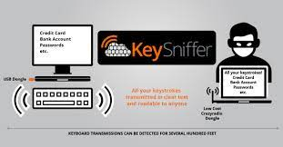

Slide 11
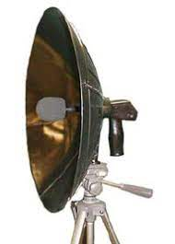
Acoustic Keylogger
This rarely used method of keystroke monitoring records the almost imperceptibly distinct sounds made when the individual keys of a keyboard are struck. It requires special equipment that “listens” to a user typing and special software that performs statistical analysis on captured data. Parabolic microphones are an example of a long distance device.

Slide 12
Software Keyloggers
Software keyloggers capture keystroke information as it passes between the computer keyboard interface and the OS. Keylogging applications use a hooking mechanism to capture keyboard data.
A common software keylogger typically consists of two files that get installed in the same directory: a dynamic link library (DLL) file that does the recording and an executable file that installs the DLL file and triggers it.
Many software-based keyloggers have rootkit functionality, meaning they’re able to hide in system. These programs can track activity (including keystrokes, screenshots, tap microphone and camera), save the data to hard disk, and then forward the information to cybercriminals.
These tools can reach at a few different levels:

Slide 13
Application programming interface (API) level: The most common form of keylogger software intercepts signals sent from the keyboard to the program a user is typing into.
Screen level: Known as “screen scrapers,” These types of keyloggers take regular screenshots, recording what appears on the user’s screen.
Browser level: This is the least complex and least deeply rooted of the four types, but it can still be quite dangerous. This “form-grabbing” ploy records what is typed into webforms, which may include everything from Social Security numbers to contact information to login credentials.

Slide 14
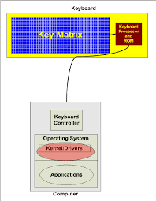
Kernel level: These are complex and difficult to write, so they aren’t especially common. Once installed, keyloggers affecting the device at the core of its operating system are especially difficult to diagnose and eradicate, as they’ve essentially been handed the “keys” to the device.

Slide 15
Example of Software Keylogging Attack
In this presentation, I will demonstrate you the example of Software Keylogging Attack through screenshots. I will be presenting you the screenshots of the step by step process of the attack. At last I will show you the log file as well. Here I am using the HATKEY Keylogger.
Requirements for Hakey Keylogger:
Python2
Kali Linux Machine
Windows Machine (Target Machine)

Slide 16
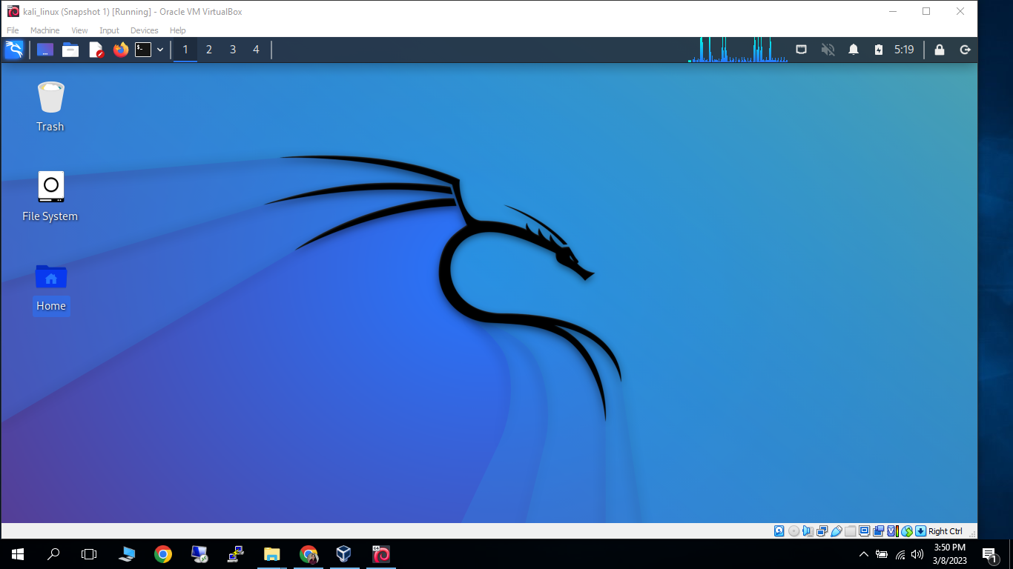
Powered On Linux Virtual Machine

Slide 17
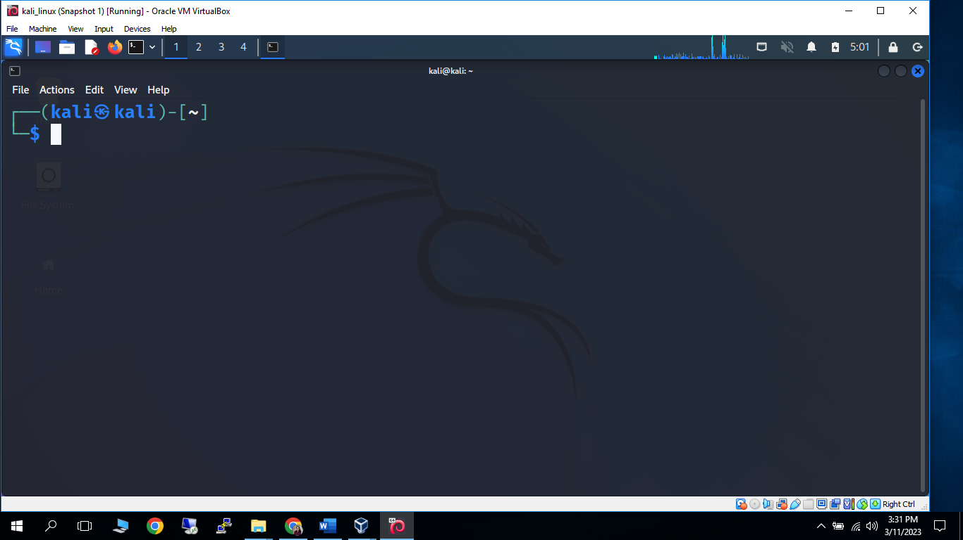
Started Linux Terminal

Slide 18
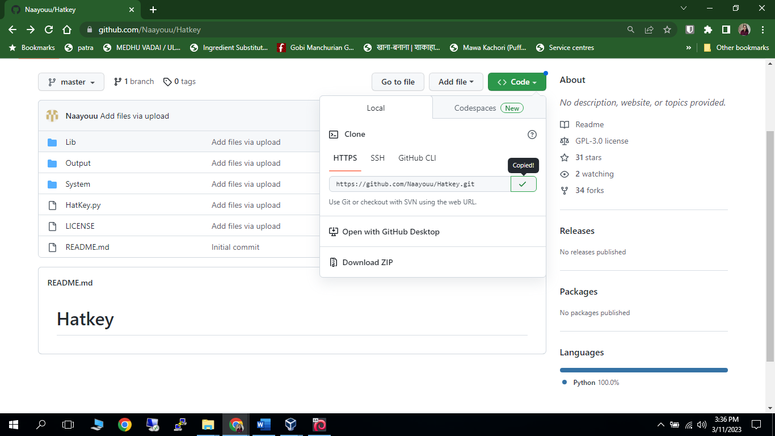
Copied HATKEY code from Github

Slide 19
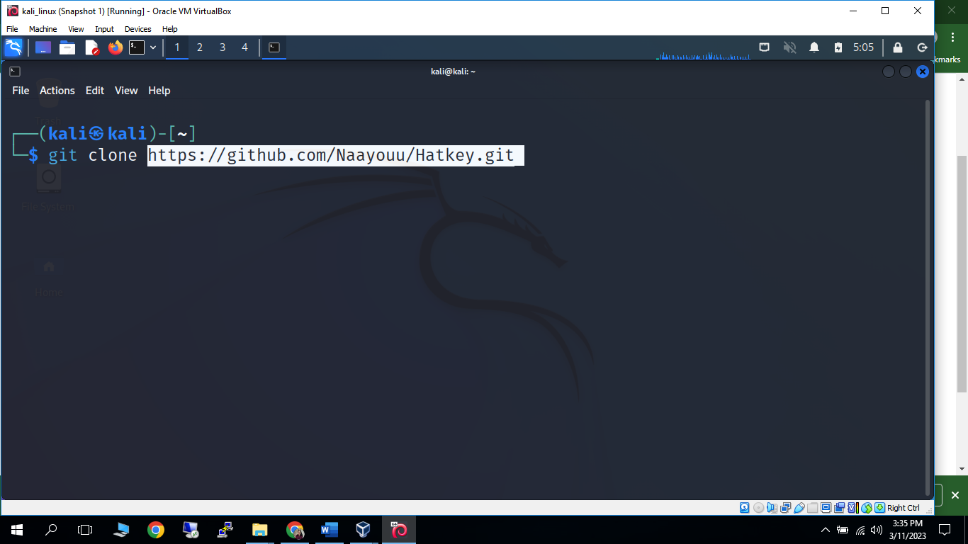
Cloning HATKEY keylogger from Github to Linux

Slide 20
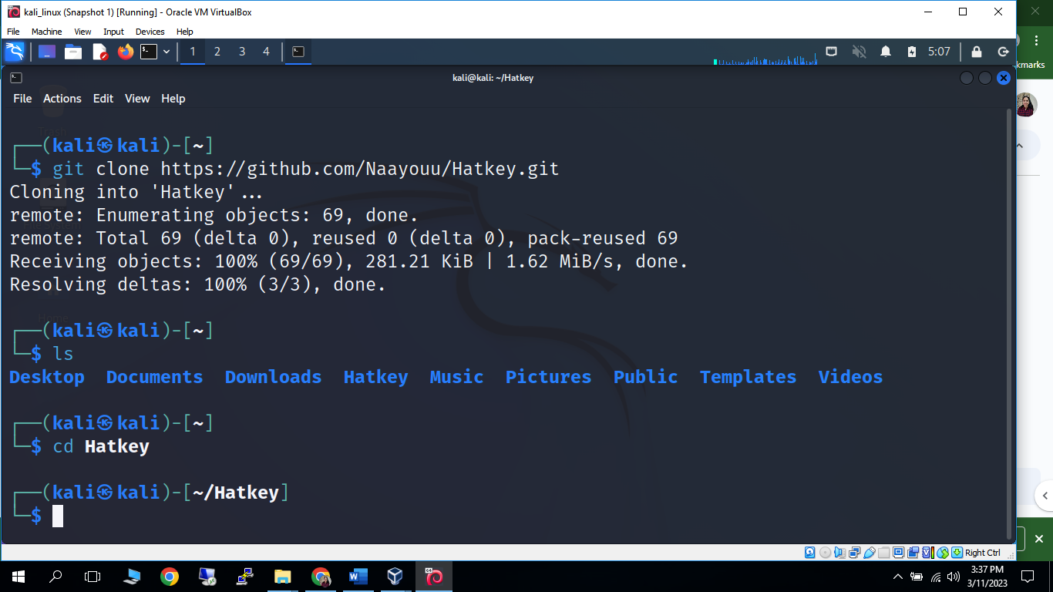
Cloned HATKEY keylogger and entered into directory

Slide 21
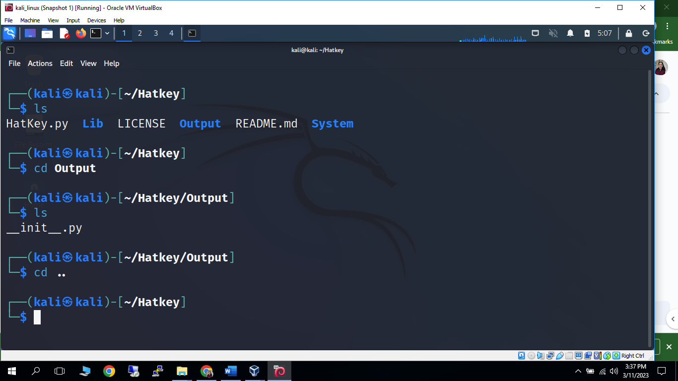
No Keylogging Log File in Output directory

Slide 22
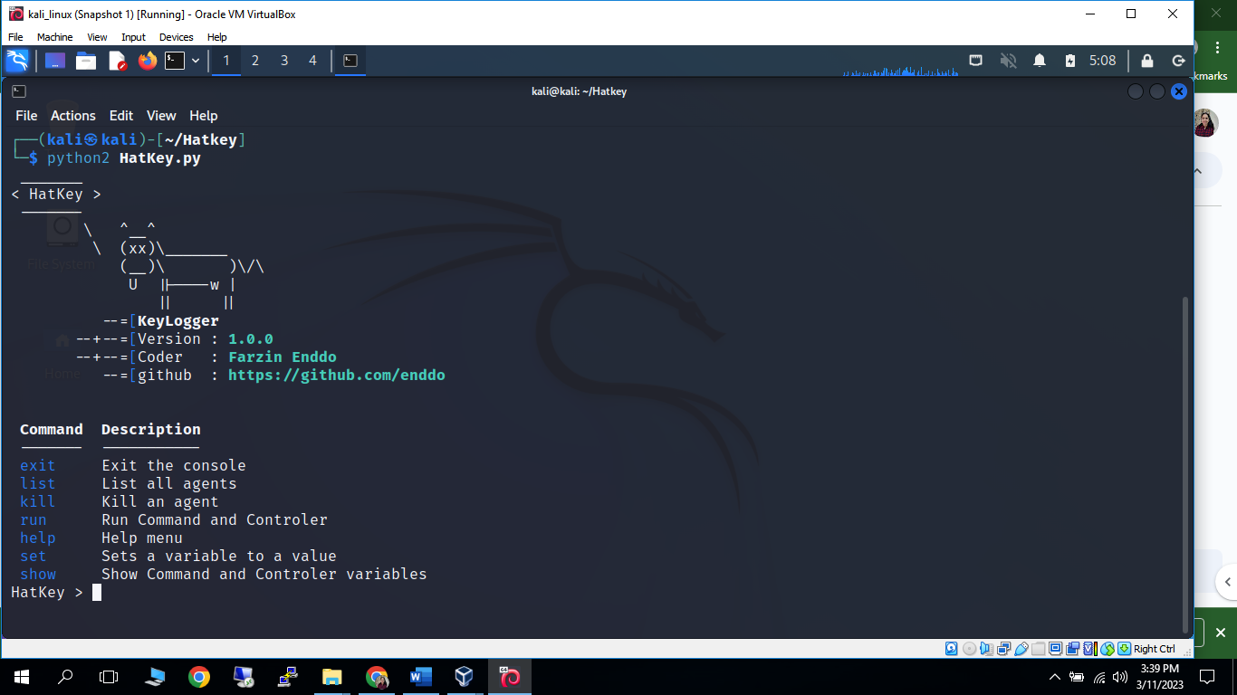
Run Python File

Slide 23
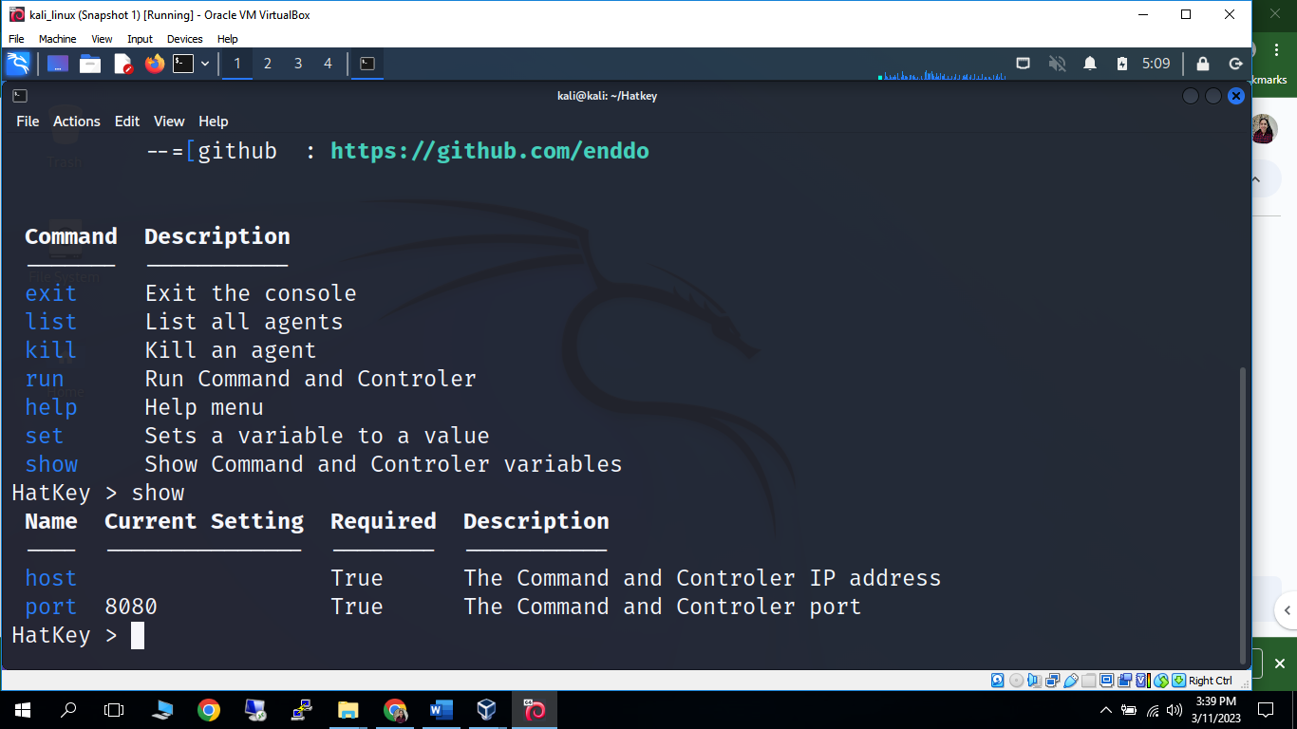
Checked for Host using ‘show’ command

Slide 24
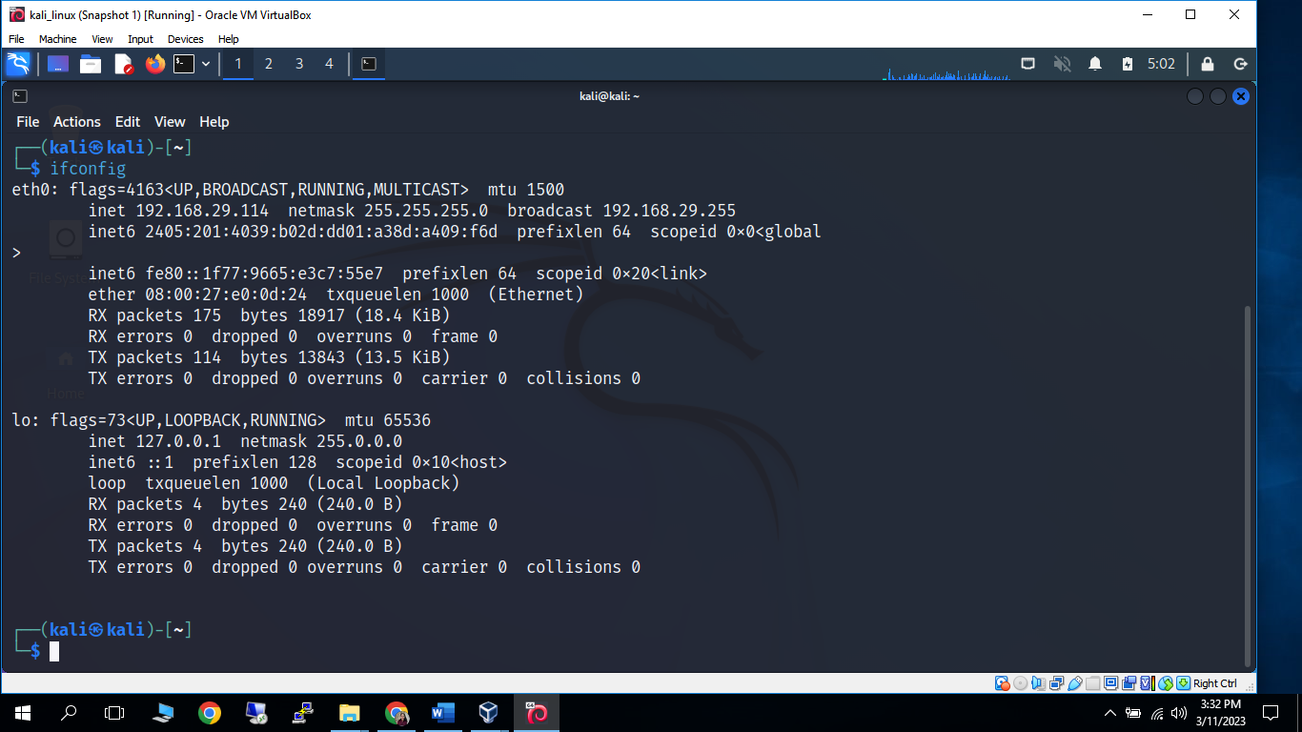
Checked for machine’s IPaddress on other terminal

Slide 25
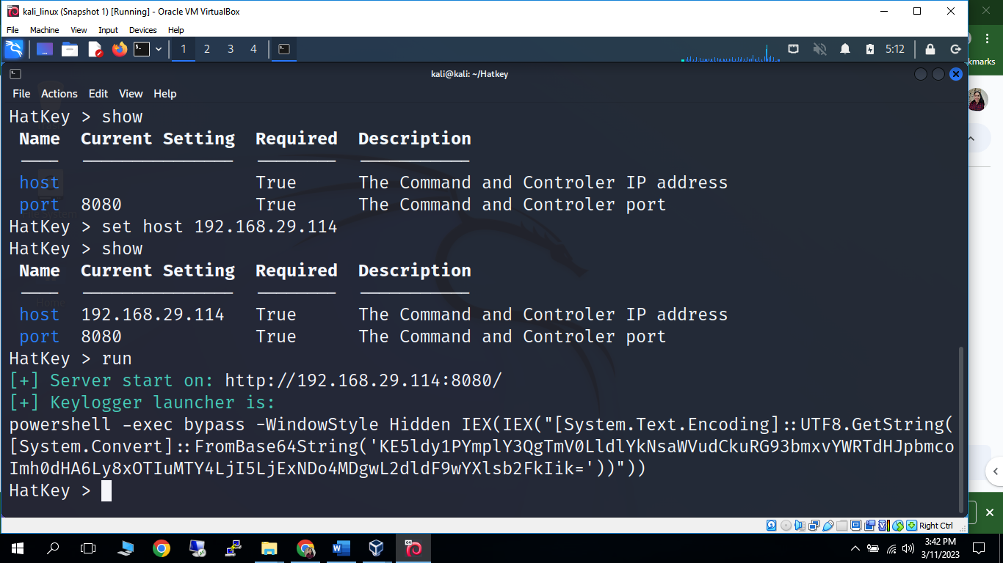
Set IPadress as Host and run the controler

Slide 26
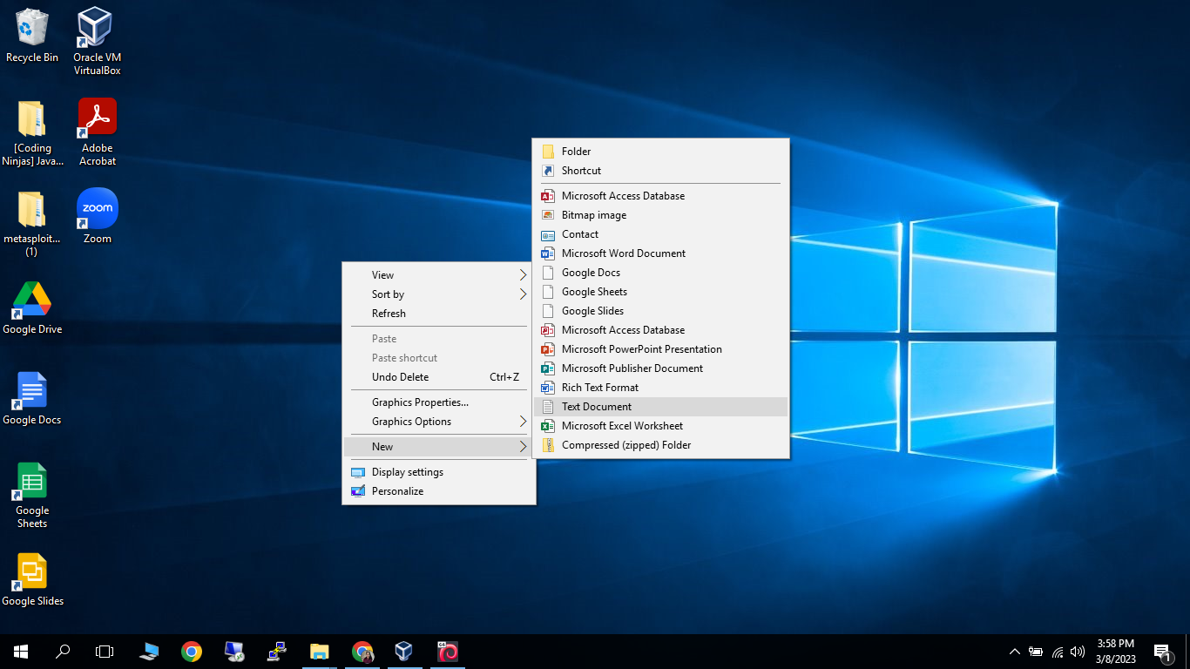
Create new Text Document on target machine (Windows)

Slide 27
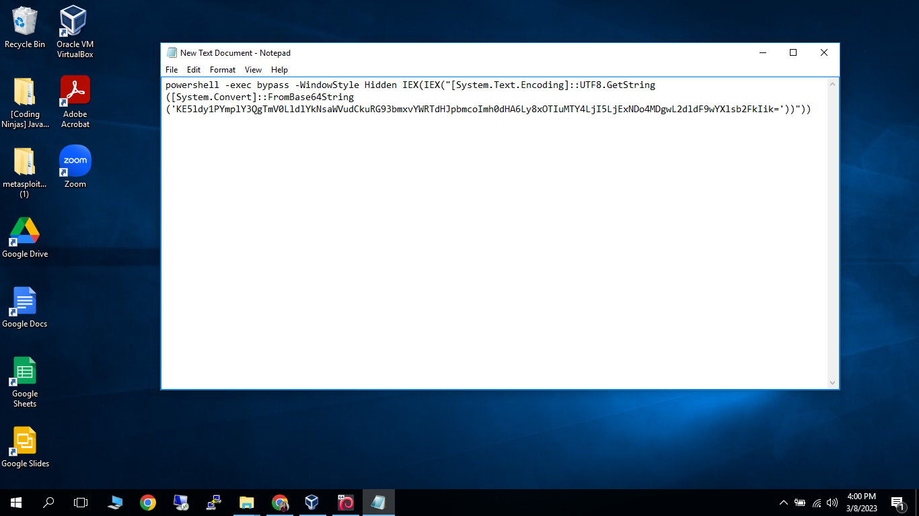
Copied the Keylogger Launcher from Linux to text file on Windows

Slide 28
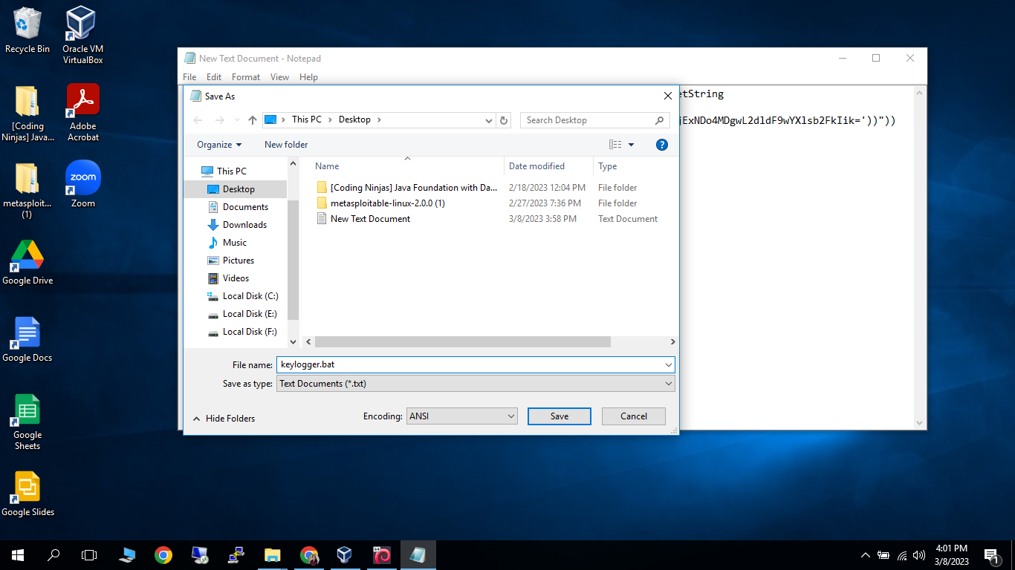
Save the text file as Bat file

Slide 29


Slide 30
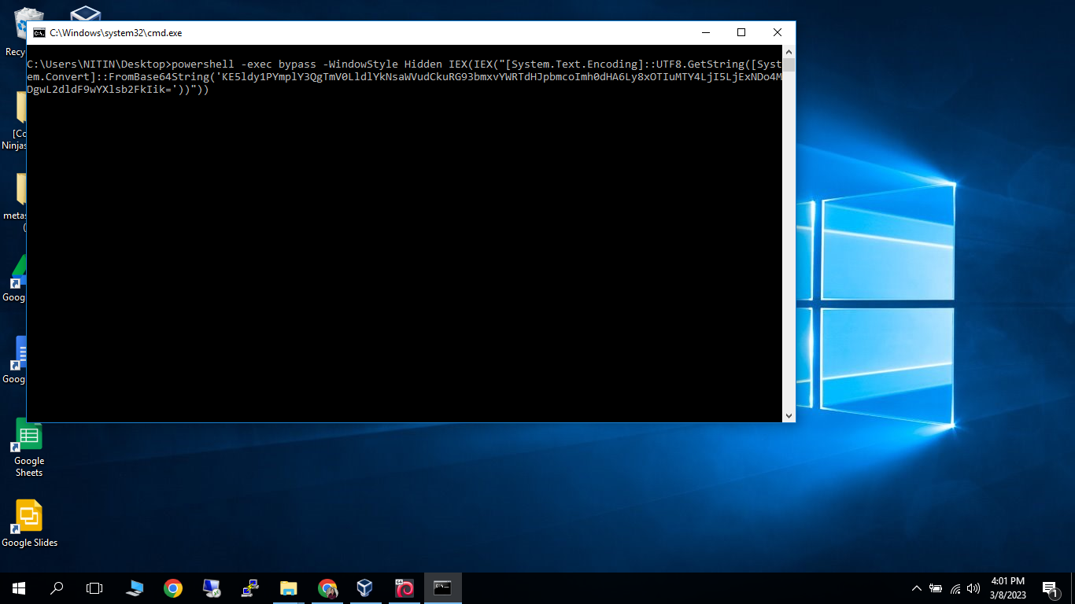
Launch the bat file

Slide 31
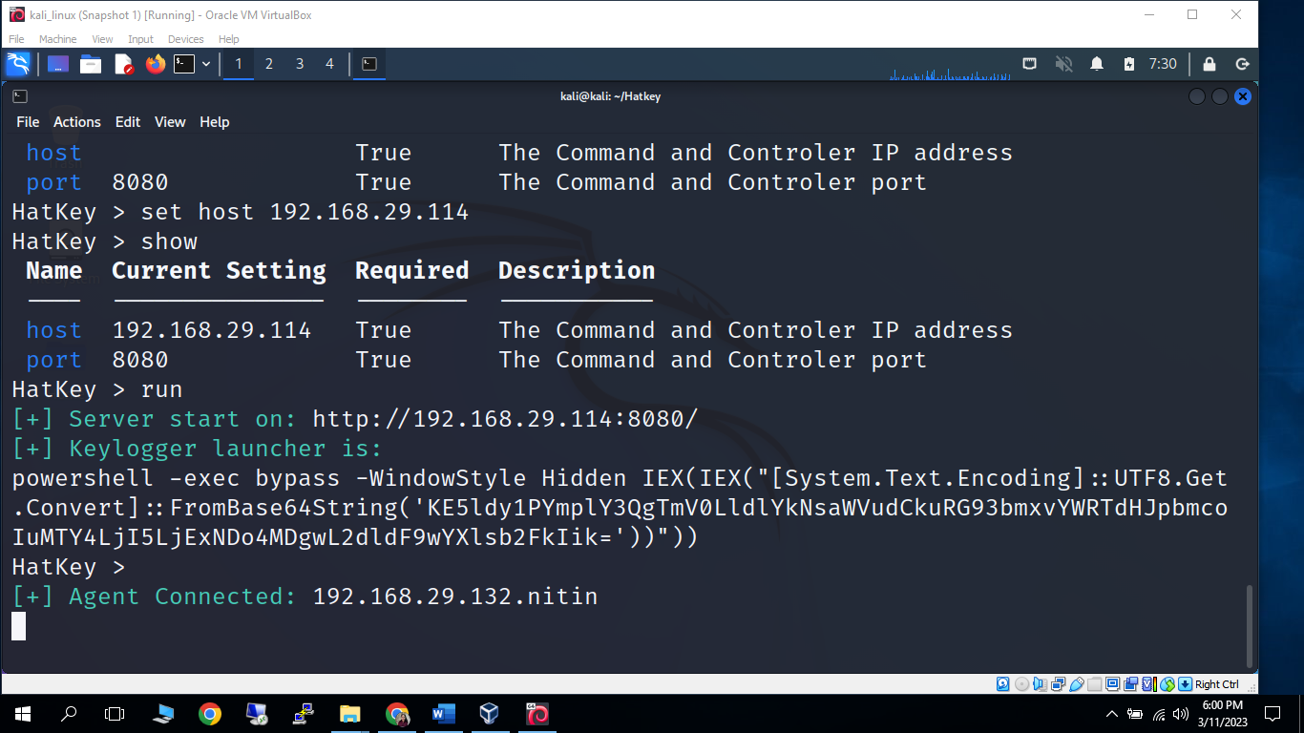
Target machine (Agent) is connected now

Slide 32

Target Machine is working

Slide 33
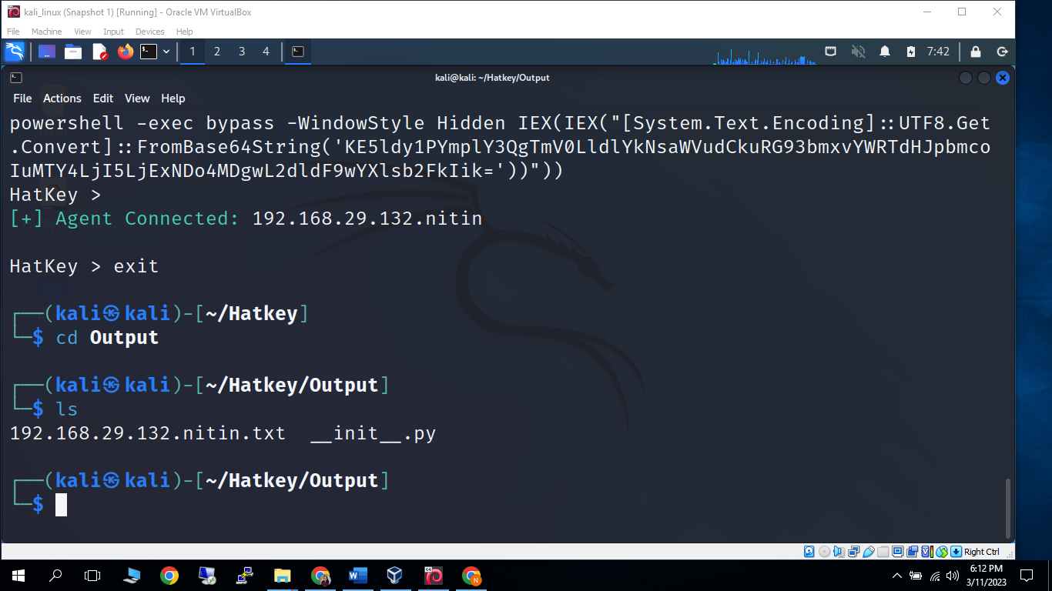
A log file generated in Output folder of Keylogger

Slide 34
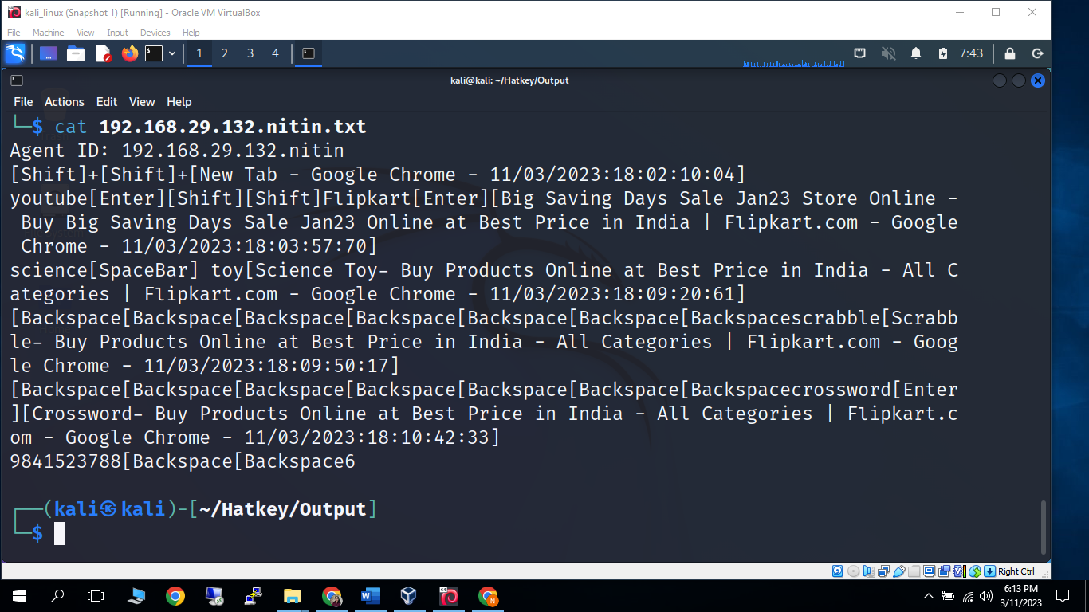
All info of Target Machine in log file

Slide 35
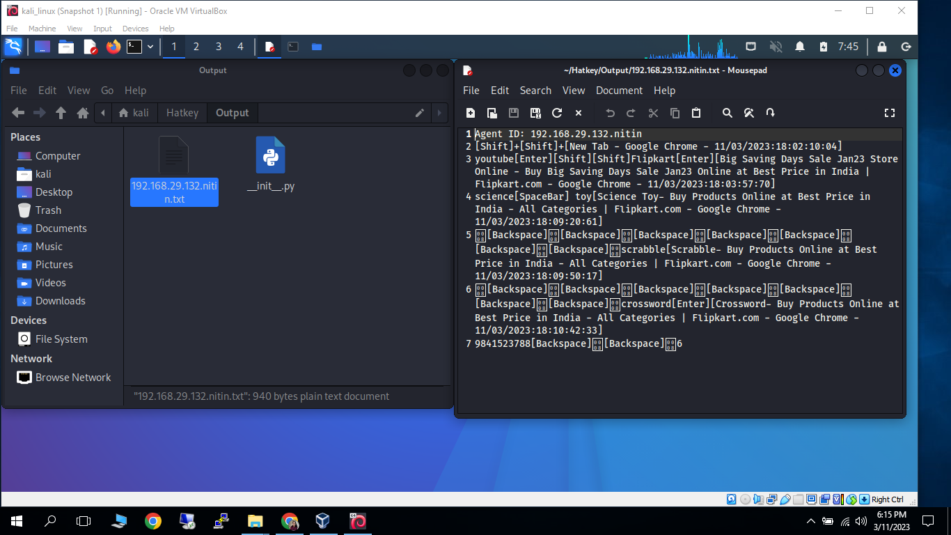
Log File and its content

Slide 36
Defending against Keyloggers
Lock systems when not in use
Implement and enforce physical security controls and check ports regularly
Install Antivirus, Antimalware and Antispywares and keep them updated
Keep Firewall on
Check programs installed on system
Close the unfamiliar tasks from the task list
Look at the contents of files that update often in the hard disk, as they might be logs.
Enable safe-surfing and don’t download unknown files
Use a password manager
Enable two-factor authentication
Consider virtual-keyboard
Consider voice-to-text conversion software

Slide 37
Conclusion
Keystroke logging attacks bypass all other controls. They are easy to implement and manage, providing attackers with useful account, identity, and intellectual property information. On the other hand, they are useful investigative tools.
Controlling keylogging technology within the organization is no different than managing other threats and tools, requiring common sense and a layered defense. The key is to be aware they exist, understand how they’re used, and implement ways to detect them, with keylogger detection and containment part of the incident response plan.

Slide 38
References
Github https://github.com/Naayouu/Hatkey
Wikipedia https://en.wikipedia.org/?title=Keylogger&redirect=no
Geeksforgeeks https://www.geeksforgeeks.org/introduction-to-keyloggers/
Techtarget https://www.techtarget.com/searchsecurity/definition/keylogger#:~:text=A%20keylogger%2C%20sometimes%20called%20a,Apple%20iPhone%20and%20Android%20devices.

